Slide 1
PWM Drawer
by ismail_iprahim

Slide 2
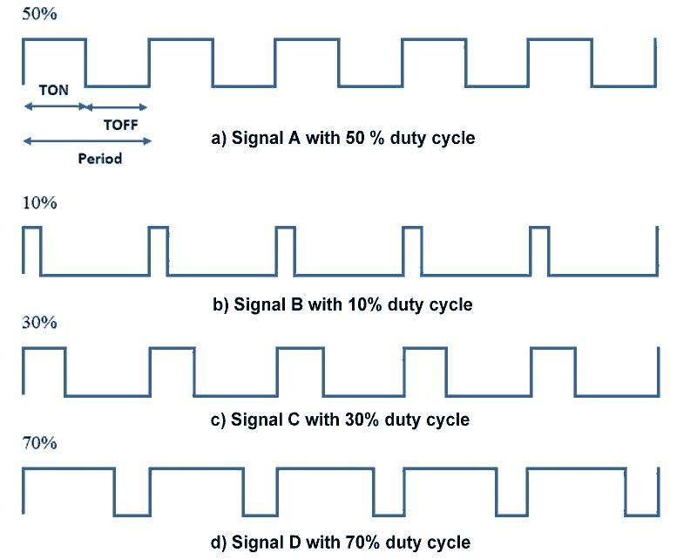
PWM drawer

Slide 3
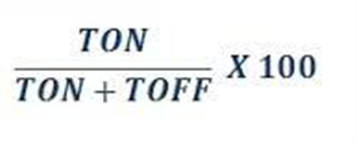
Introduction to PWM:
Pulse Width Modulation (PWM) is a technique by which the width of a pulse is varied while keeping the frequency constant.
Why do we need to do this? Let’s take an example of controlling DC motor speed, more the Pulse width more the speed. Also, there are applications like controlling light intensity by PWM.
A period of a pulse consists of an ON cycle (5V) and an OFF cycle (0V). The fraction for which the signal is ON over a period is known as the duty cycle.
Duty Cycle (In %) =

Slide 4
Components:
1- microcontroller ATMEGA 32
2- graphical LCD

Slide 5
how to generate PWM using timer?
2 timers. 1st timer is for TON and 2nd timer is for TOFF. Configure (Values of TON and TOFF are depends on value of duty cycle and frequency of PWM , as described in above sections)
Start TON timer (with TON time of pulse) once timer reaches to certain time value, stop 1st timer and start 2nd timer (with TOFF time of pulse). This can be done by using ISR of timers. Once timer 1 ISR executed, start Timer 2 and in timer 2 ISR start timer 1
When 1st timer is started. set digital out pin to High (logic 1) and when 2nd timer started set same digital out pin to Low (logic 0).

